Slide 1
TRAVLENDAR+
Federico Betti – Tommaso Bianchi

Slide 2
RASD

Slide 3
Product Functions
Travel
Meeting
Meeting-meeting or default location-meeting
Biking, Driving, Walking, Public Transportation
Preference list
Constraints
Real-time indications
Title, date and location
Administrators
Accept, decline or reschedule the invitation
Chat, upload files and notes
Categories and subcategories
Notes:
Travlendar for us

Slide 4
User Characteristics
USER
Login
Create Meeting
Calendar
Groups and Contacts
GUEST
Registration
ADMINISTRATOR
Manage Meeting
Invite/Remove Users
Recreate Meeting
Monitor Participants Delays
SYSTEM MANAGER
Travlendar+ employee

Slide 5
Goals
G1 Allow someone to visit the homepage of the system and to register himself providing a valid email, a password and a unique nickname. As an alternative, an external login provider, such as Google+, can be used.
G2 Users can log into the system.
G3 Allow a user to visit its profile and to see a detailed schedule of any day containing all the meetings he is attending and all the travels the system has planned him.
G4 Allow a user to edit all information in its profile (e.g. displayed name, phone number, company, website, social accounts).
G5 Allow a user to create a meeting and to invite other users to attend it.
G6 Allow a user to know when there are problems in scheduling its meetings, signaling them with warnings.
G7 Allow a user to specify flexible breaks during the day.
G8 Manage users’ travels between subsequent meetings, suggesting the best mobility option according to their preference list.

Slide 6
Goals
G5 Allow a user to create a meeting and to invite other users to attend it.
G5.4 Allow the administrator to send invitations and remove participants.
G5.5 Allow the team to communicate between them, to share files and to save personal notes about the meeting.
G5.6 Allow the invited users to accept or decline the meeting or to propose a rescheduling in a different time slot.
G5.7 Allow the administrator to change the date of the meeting after a rescheduling has been proposed.
G5.8 Allow the administrator to poll the team to reschedule the meeting; if everyone accepts the rescheduling, the date changes.
G5.9 Allow the administrator to create a copy of a meeting with the same team and settings on another date.
G5.10 Allow the administrator to see who’s late at the meeting.

Slide 7
Goals
G6 Allow a user to know when there are problems in scheduling its meetings, signaling them with warnings.
G6.1 Allow a user to decline or reschedule overlapping meetings in order to remove the warning.
G7 Allow a user to specify flexible breaks during the day.
G8 Manage users’ travels between subsequent meetings, suggesting the best mobility option according to their preference list.
G8.1 Allow a user to create a preference list and constraints about the way he wants to travel.

Slide 8
Requirements
G5 Allow a user to create a meeting and to invite other users to attend it.
[R5] A user must be logged into the system to perform any action except registering and logging in.
[R12] Each participant in a meeting can access shared files and the chat.
[R13] Users participate in a meeting if and only if they accept the invitation.
[R14] Users do not participate in a meeting if they decline the invitation.
[R15] Users can write in the chat of a meeting if and only if they have received and accepted an invitation to it.
Notes:
0,5

Slide 9
Requirements
G6 Allow a user to know when there are problems in scheduling its meetings, signaling them with warnings.
[R16] For each meeting there is a warning iff the meeting is inconsistent.
G7 Allow a user to specify flexible breaks during the day.
[R17] The system suggests you a time, according to your settings, to have a break such that no meeting overlaps with it; if no time slot is valid, a warning is generated.
G8 Manage users’ travels between subsequent meetings, suggesting the best mobility option according to their preference list.
[R19] The travel mean suggested by the system is always the ﬁrst in the weighted preference list that satisﬁed all the constraints; if no travel mean satisﬁed all the constraints than the system suggests the fastest one.
Notes:
0,75

Slide 10
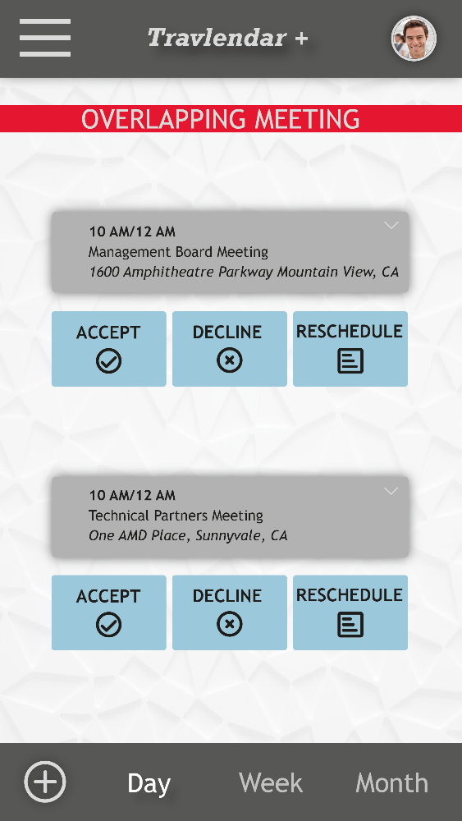
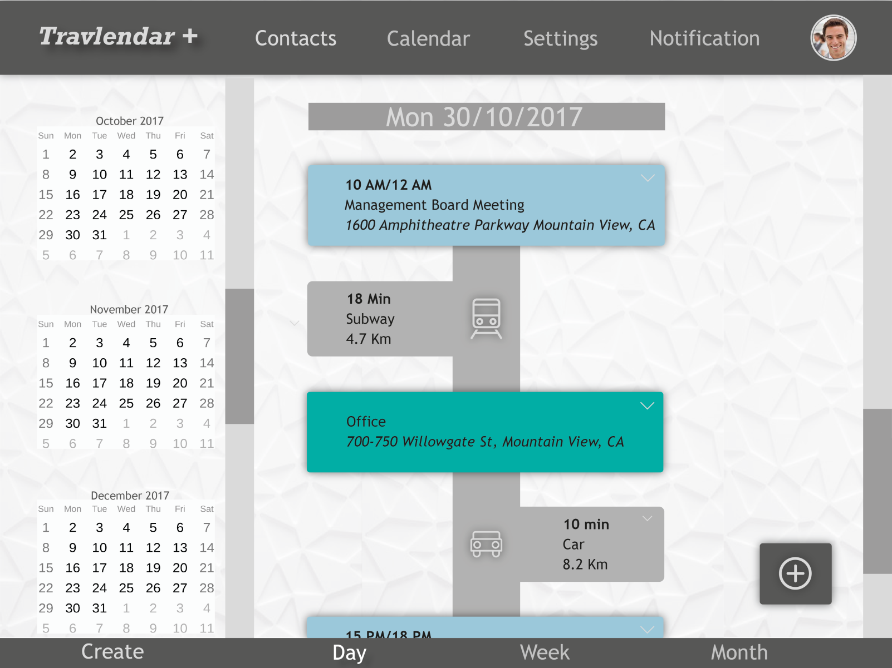
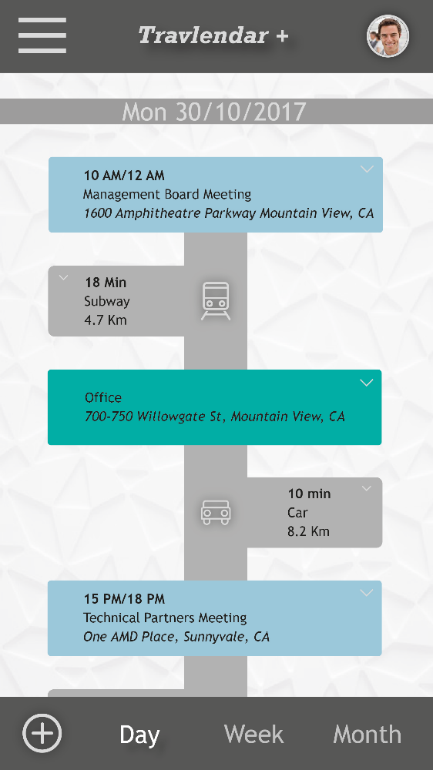
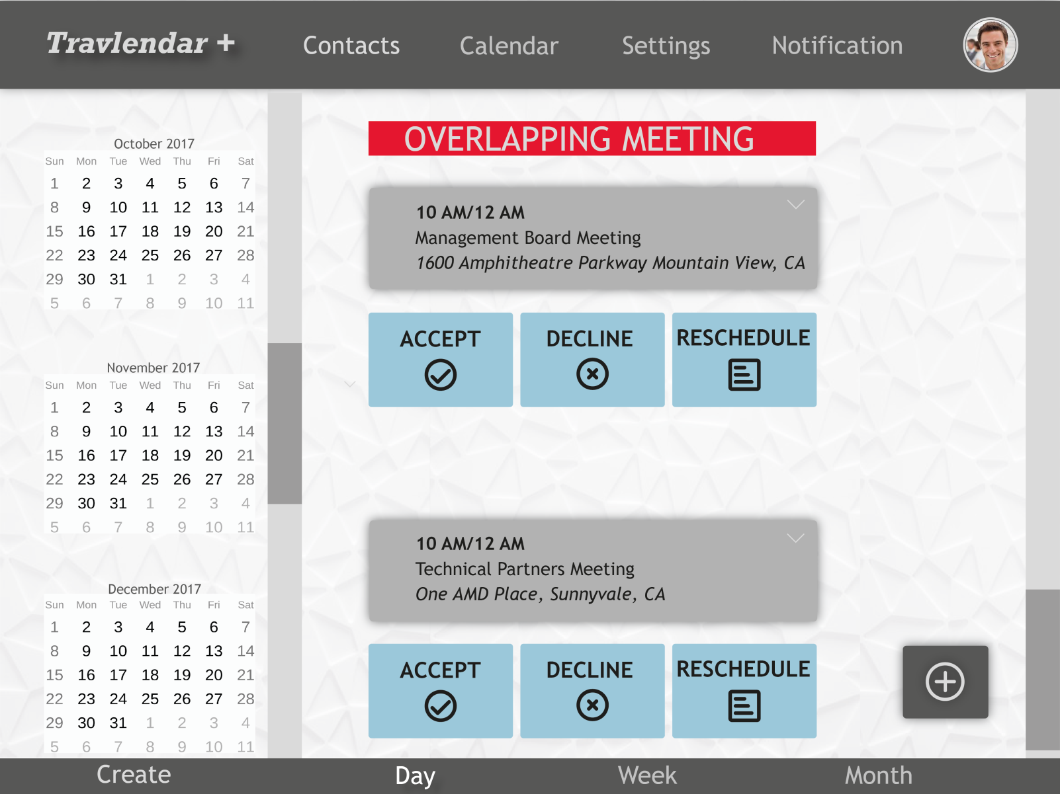
Mockup - Calendar
Notes:
0,5

Slide 11
Mockup - Warning
Notes:
0

Slide 12
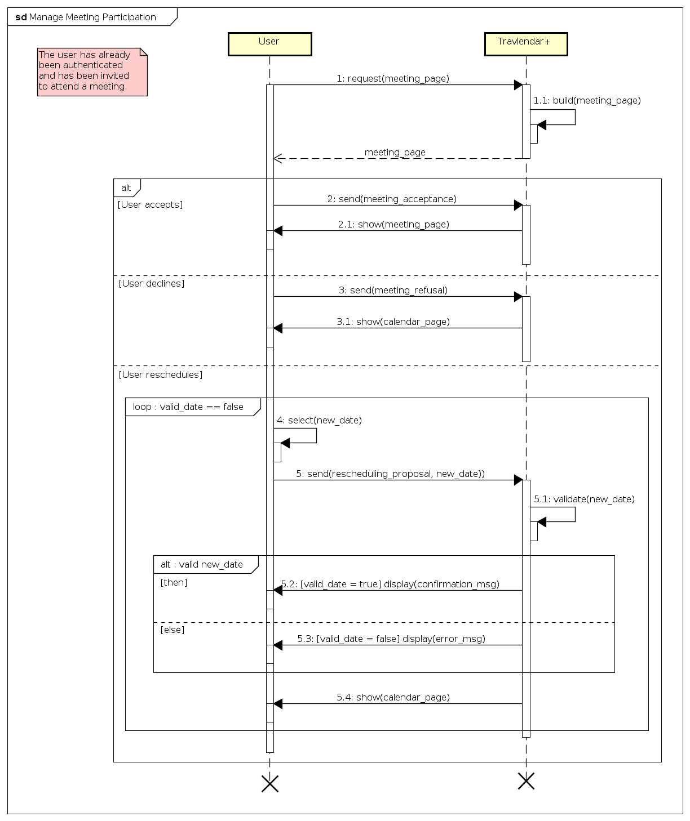
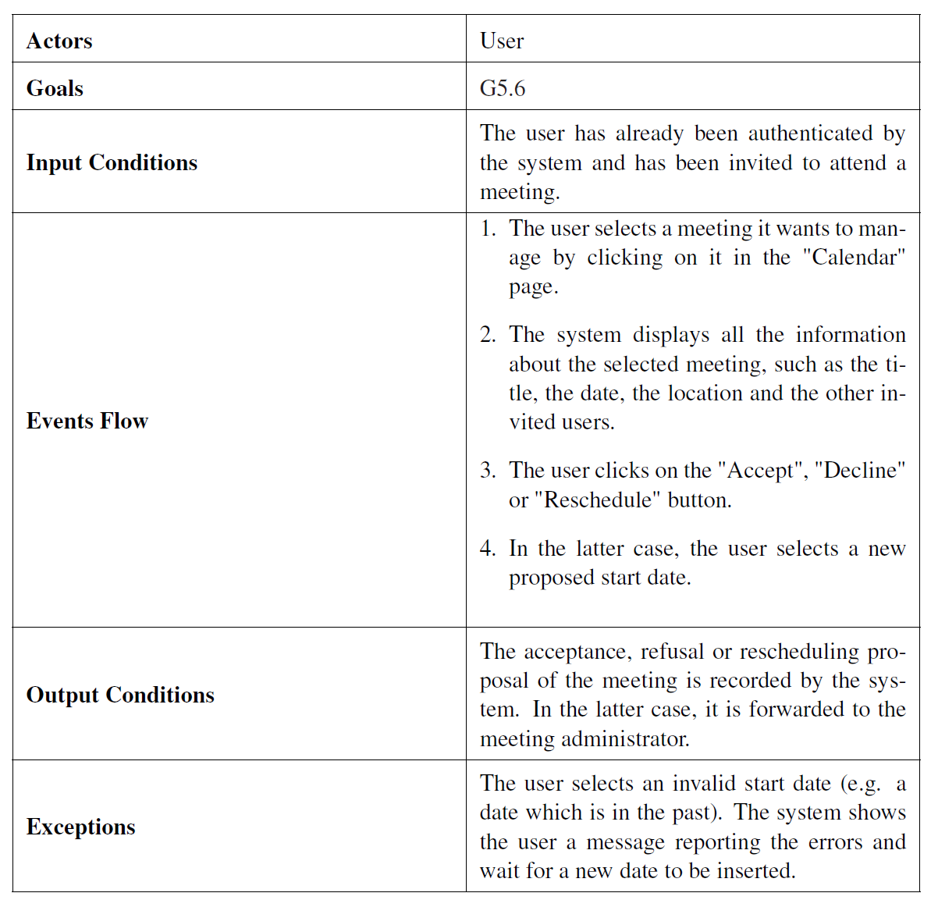
Use Case and Sequence Diagrams
Notes:
0,5+

Slide 13
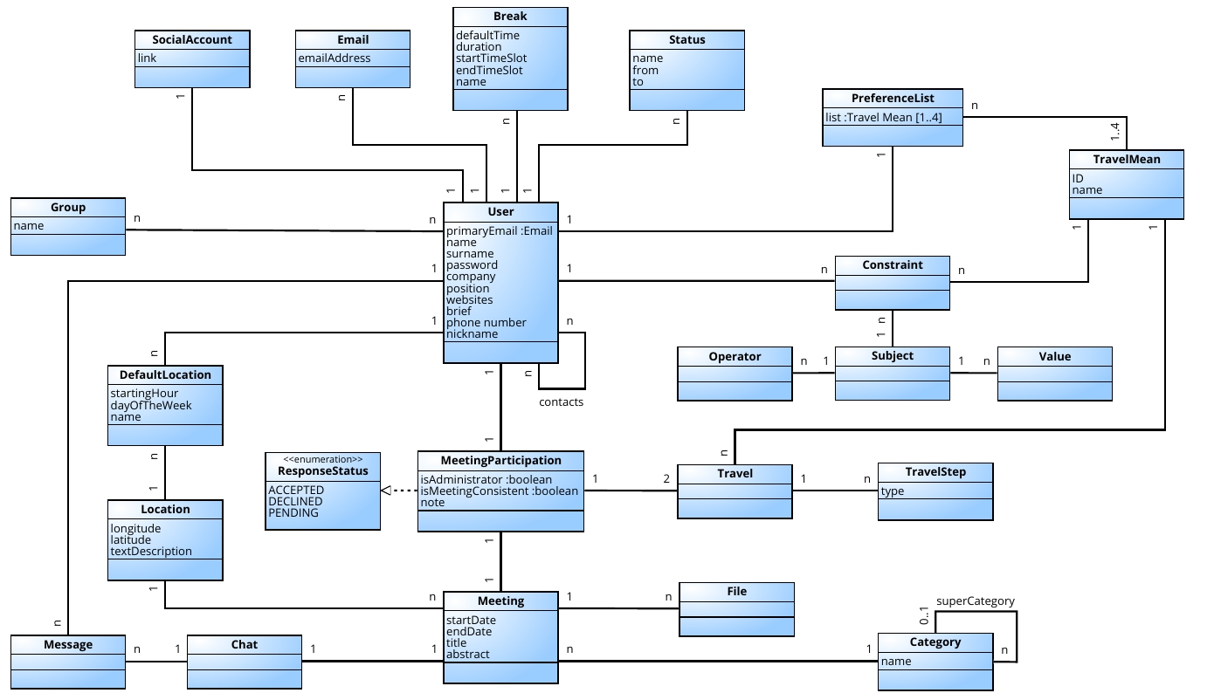
Class Diagram
Notes:
0,5

Slide 14
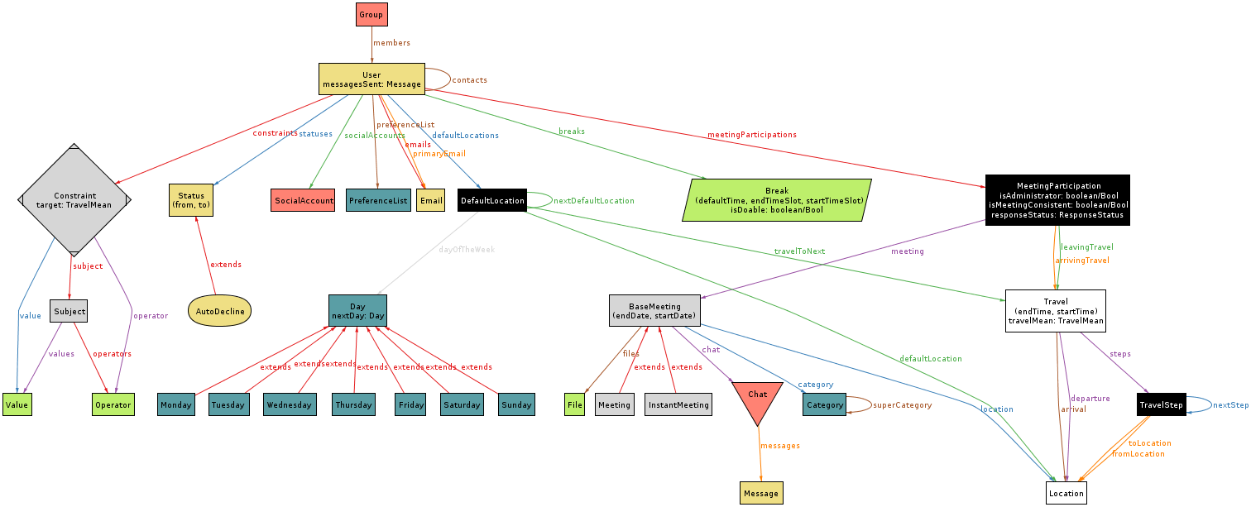
Alloy Metamodel
Notes:
1

Slide 15
DD

Slide 16
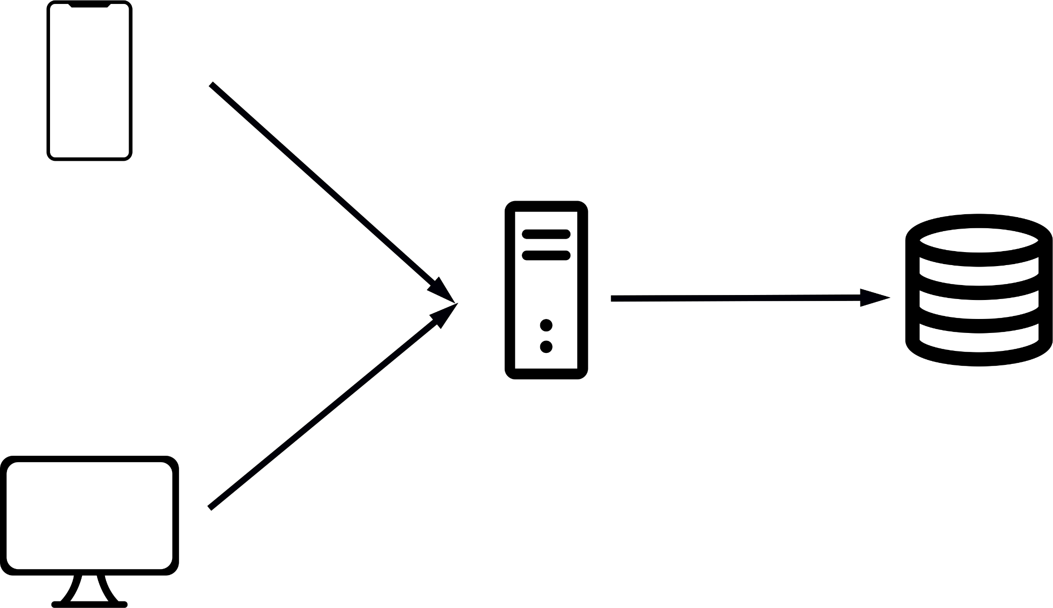
Architectural Style
Notes:
0,5

Slide 17
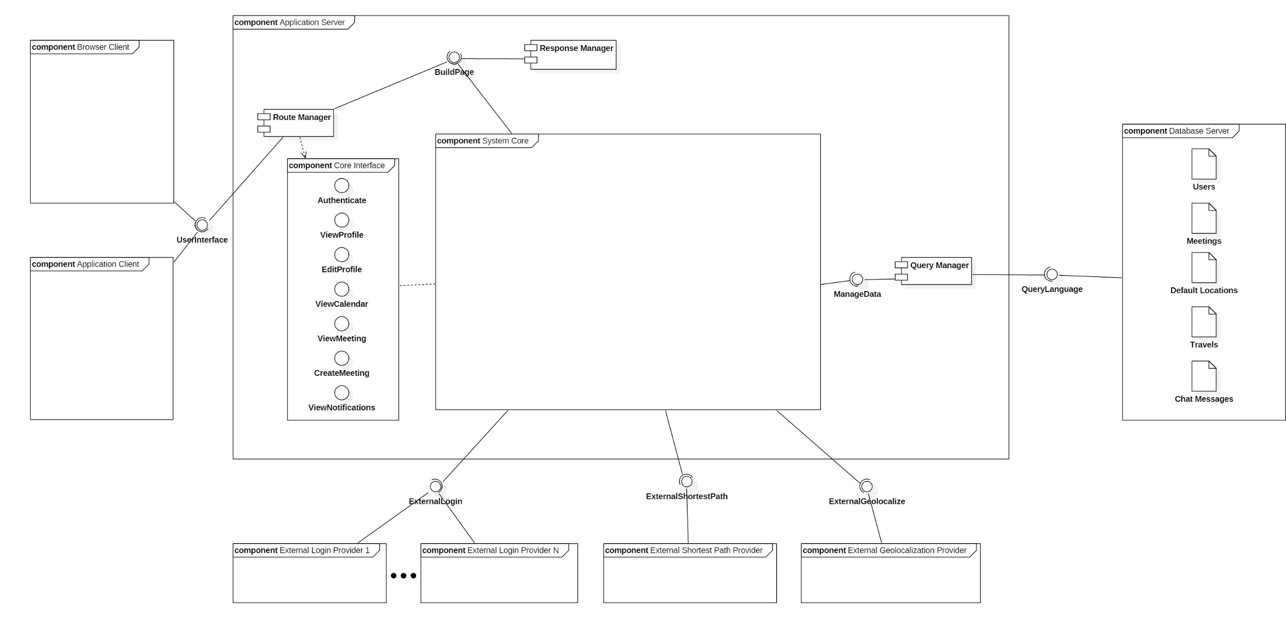
High Level Component Diagram
Notes:
0,5+

Slide 18
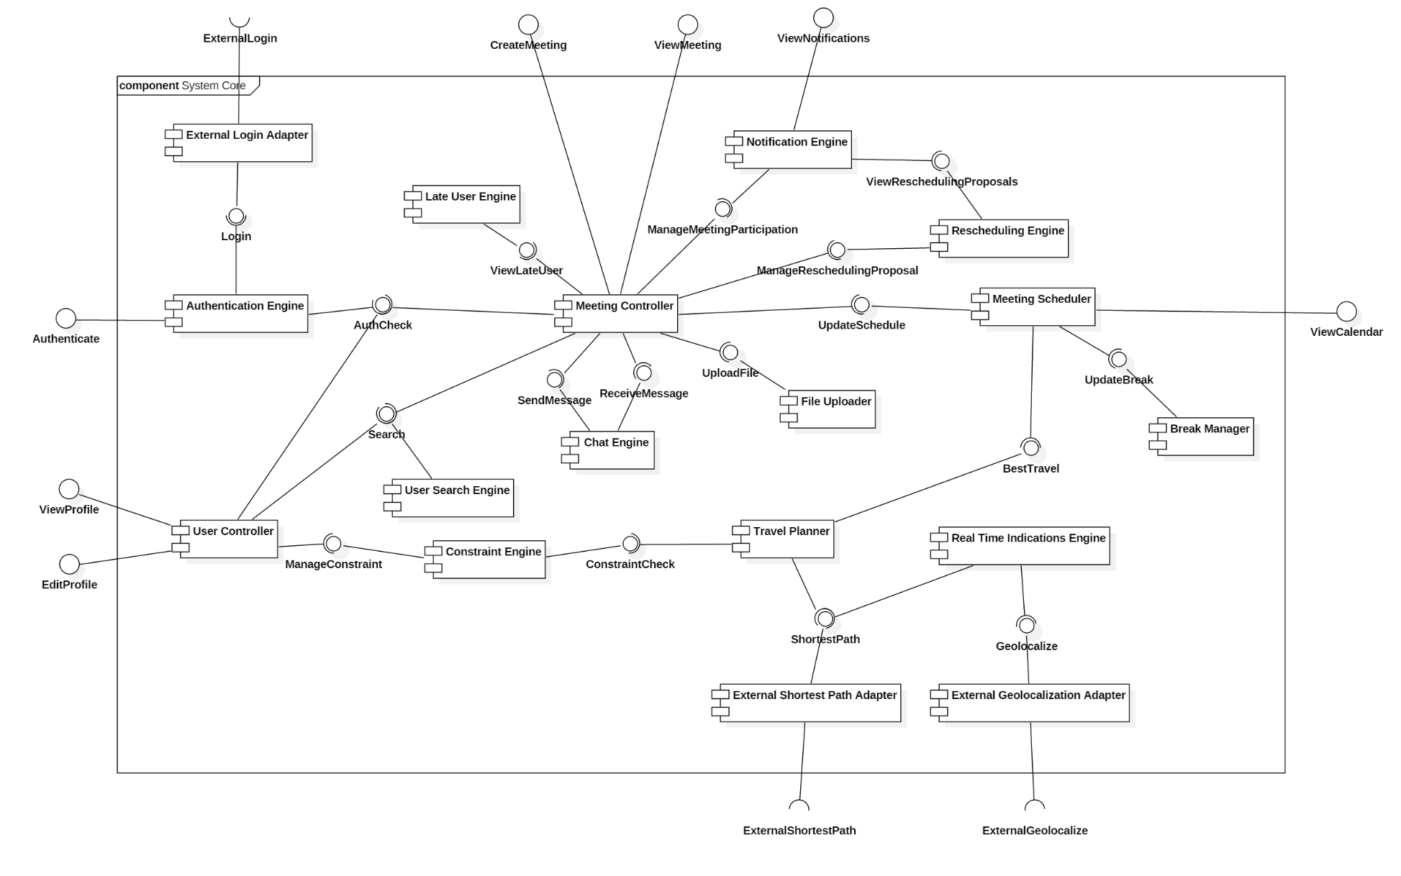
System Core Component Diagram
Notes:
0,5+

Slide 19
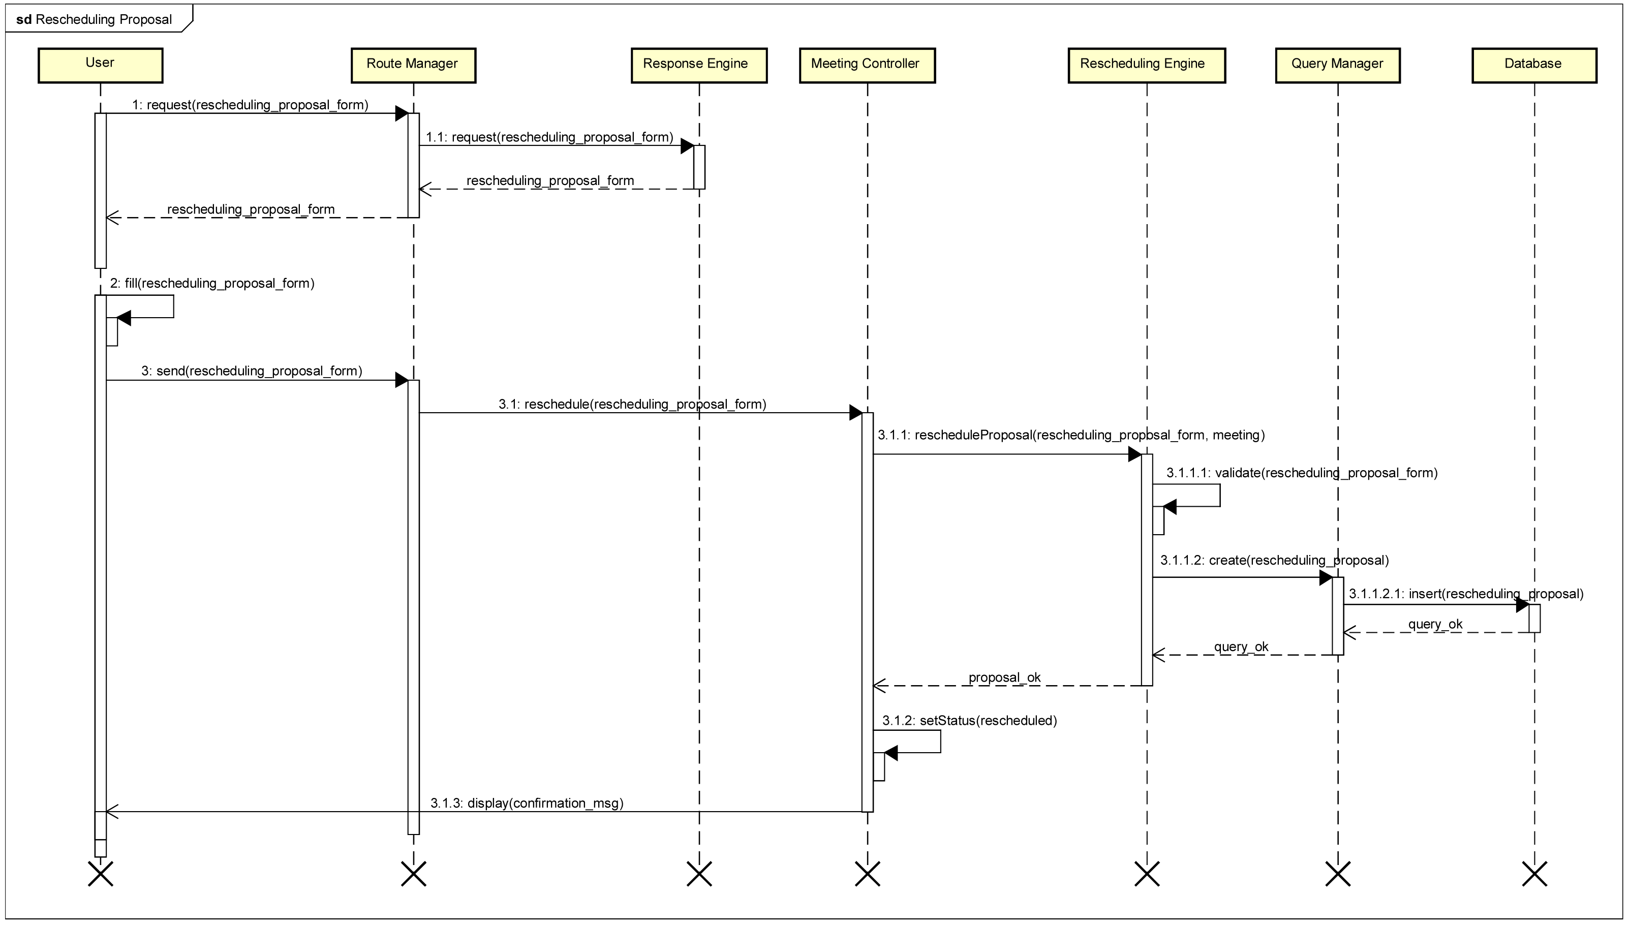
Runtime Diagram
Notes:
0,5

Slide 20
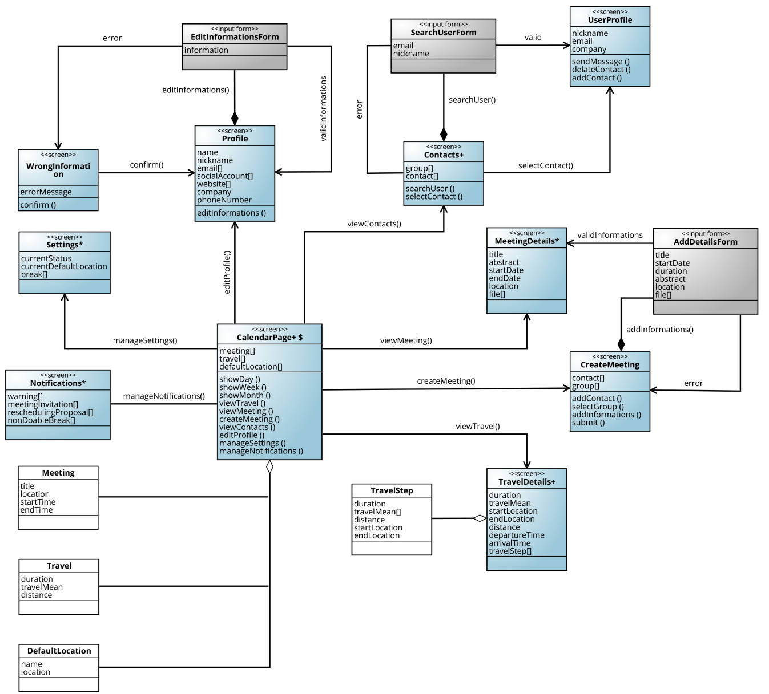
UX Diagram

Slide 21
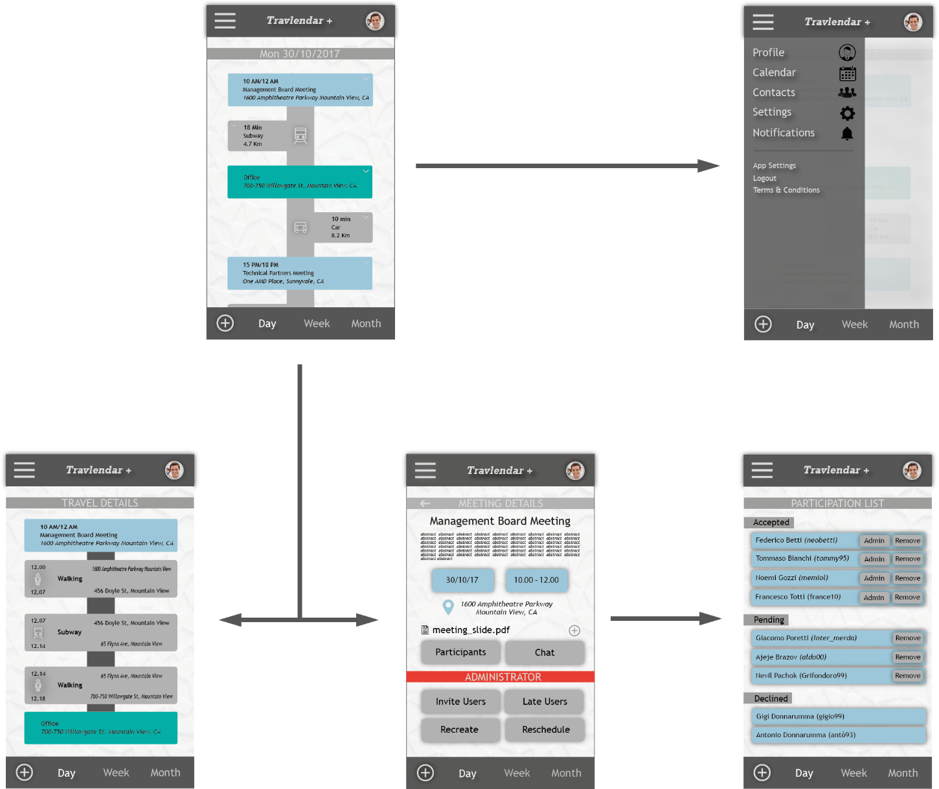
Mockups

Slide 22
Algorithm Design
Insert_meeting function main steps:
Find all the meetings overlapping with the one that we are inserting and mark them as inconsistent; if at least a meeting is found, mark also the new one as inconsistent and terminate the function.
Try to compute a travel for arriving and for leaving the newly inserted meeting taking into account the previous meeting, the following one and the default locations; if this is not possible, terminate the function marking the new meeting and the conflicting one as inconsistent.
Adjust the effective time of all the flexible breaks overlapping with the new meeting; if this is not possible, mark the break as not doable.
Link the travels to the meeting and store everything, then terminate successfully.

Slide 23
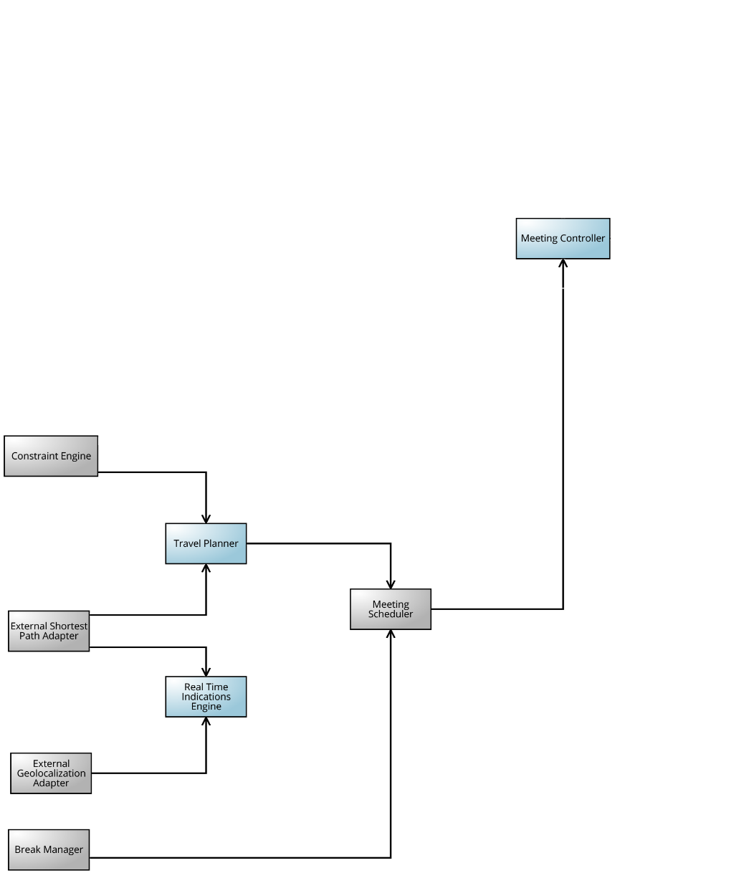
Implementation & Integration

Slide 24
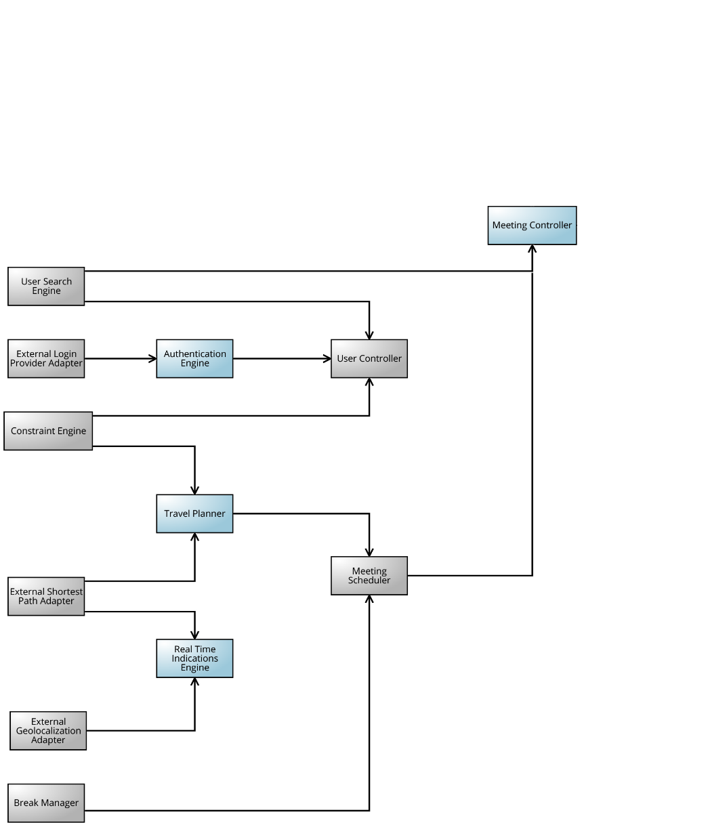
Implementation & Integration

Slide 25
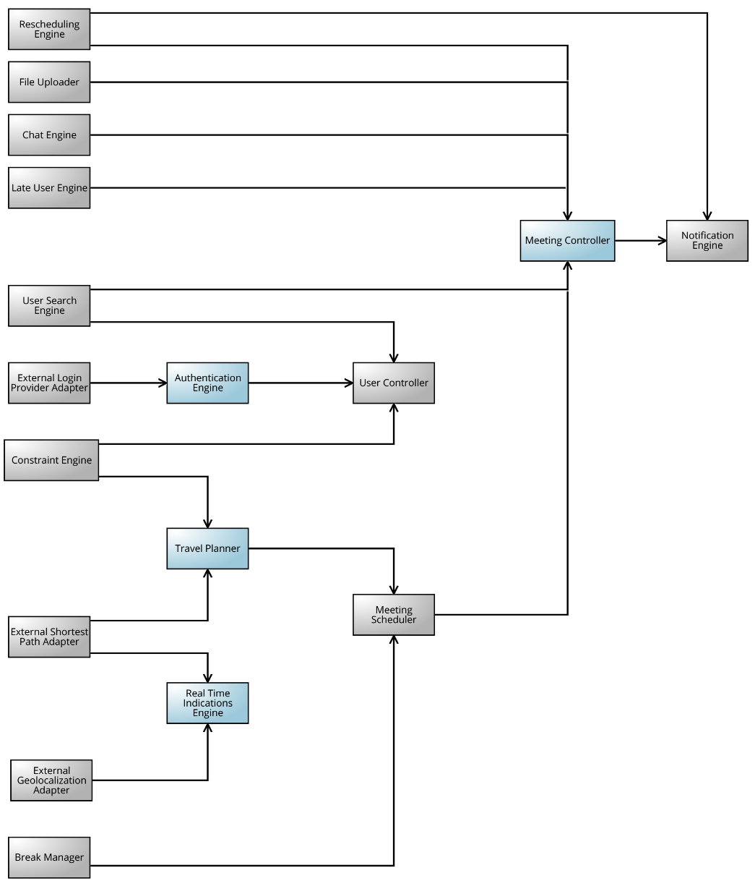
Implementation & Integration

Slide 26
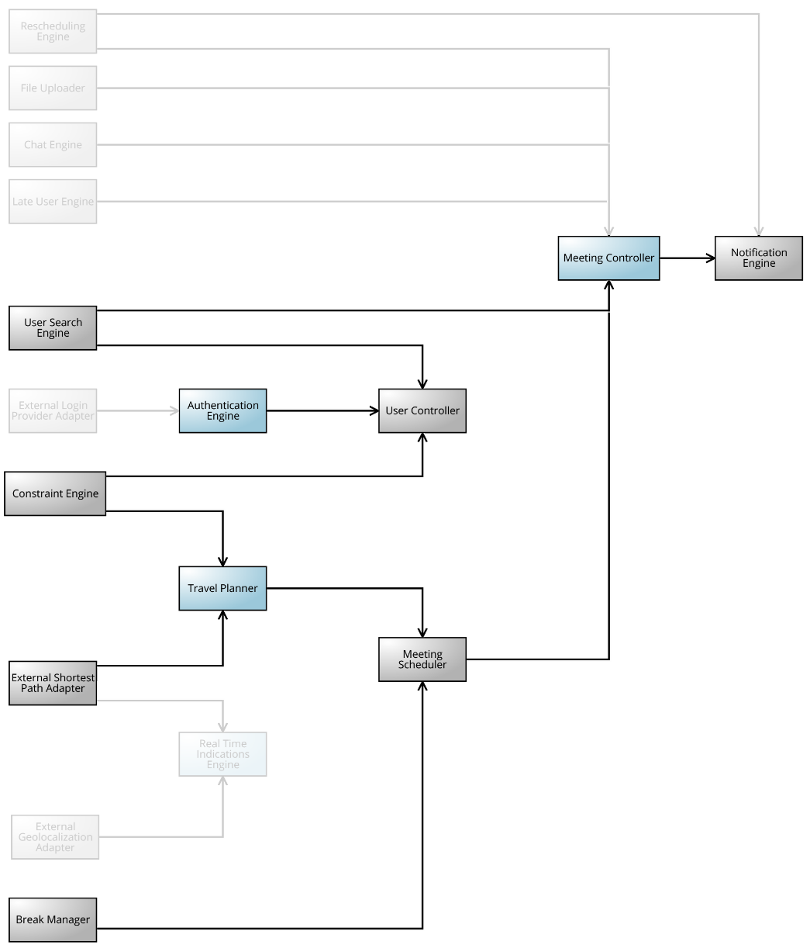
Implementation & Integration

Slide 27
ITD

Slide 28

Ruby on Rails
Server-side web application framework.
Ruby language
Model View Controller, Convention over Configuration, Don’t Repeat Yourself, Active Record
Very fast development cycles
Active Community
Heroku

Slide 29
Ruby on Rails
Advantages
disadvantages
Ruby on Rails is an opinionated framework
Speed of Development
Rails is an open-source web framework supported by an active community
Runtime Speed and Performance
A lot of hard dependencies and modules included out of the box
High cost of wrong decisions in development
Lacks tools for very large projects

Slide 30
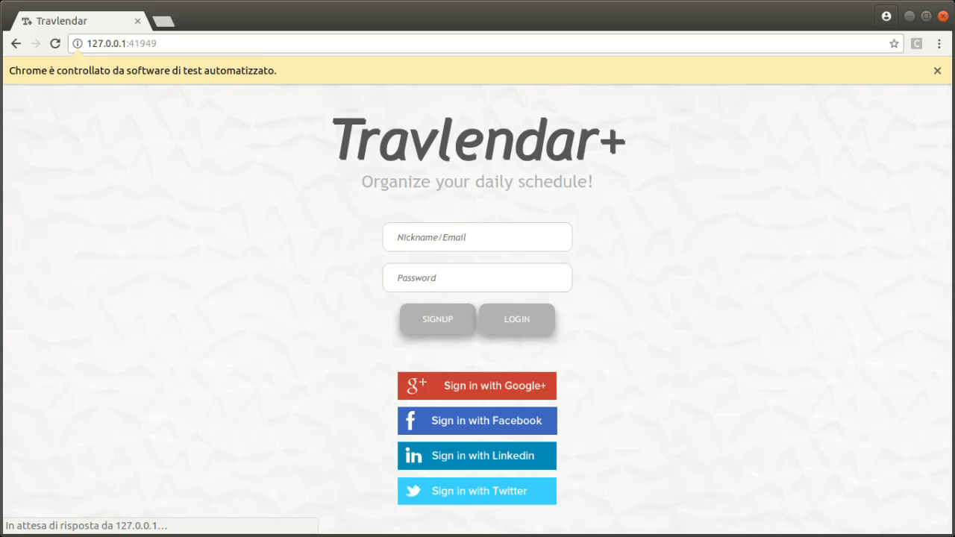
Testing
Model Tests
System Tests
Login and Signup
Section Navigation
Meeting Creation
Default Location Creation
Break Creation
Notes:
1

Slide 31
Implemented Requirements
Implemented
Not implemented
[R3] Users have to be registered into the system before logging in
[R16] For each meeting there is a warning iff the meeting is inconsistent
[R17] The system suggests you a time, according to your settings, to have a break such that no meeting overlaps with it; if no time slot is valid, a warning is generated
[R19] The travel mean suggested by the system is always the ﬁrst in the weighted preference list that satisﬁed all the constraints; if no travel mean satisﬁed all the constraints than the system suggests the fastest one
[R6] Users cannot have meetings while their status is set to auto-decline
[R8] Time travel between subsequent default locations should be less than the difference between their start time
[R12] Each participant in a meeting can access shared ﬁles and the chat
[R4] Users can use a supported external login system in order to log in
Notes:
1

Slide 32
DEMO

